Slide 1
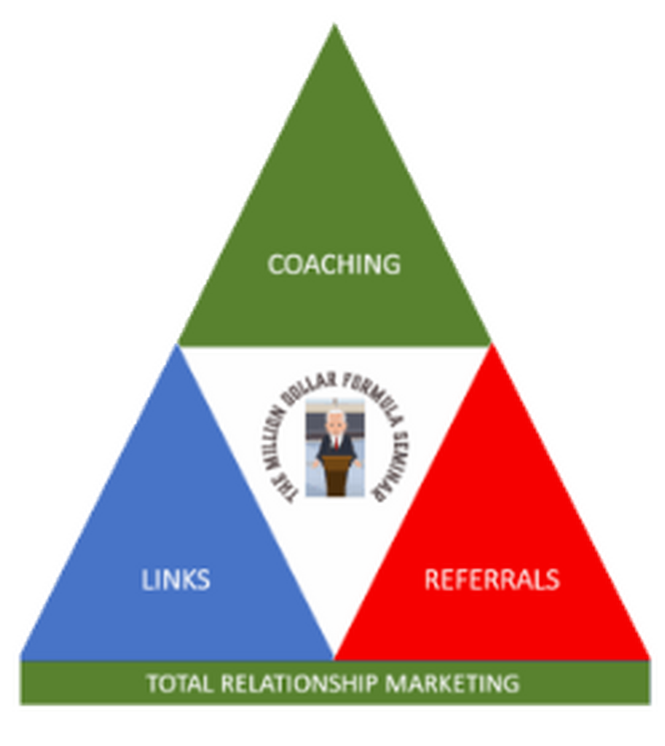
TOTAL RELATIONSHIP
MARKETING
Turning “Six Degrees of Separation into One”
PREVIEW
COACHING • LINKS • REFERRALS
TOTAL RELATIONSHIP MARKETING • PREVIEW • 01 / 12
Notes:
[Sources]
- User-provided Total Relationship Marketing logo and wording.

Slide 2

TOTAL RELATIONSHIP MARKETING • PREVIEW
TOTAL RELATIONSHIP MARKETING, LLC is a membership-based business development company founded upon the premise that
TOTAL RELATIONSHIP MARKETING • PREVIEW • 02 / 12
Notes:
[Sources]
- User-provided Total Relationship Marketing logo and wording.

Slide 3
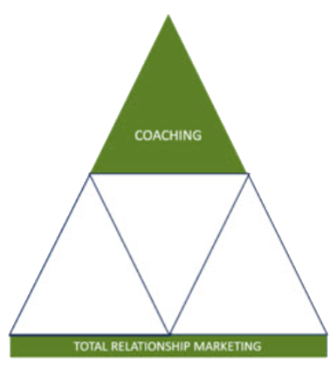
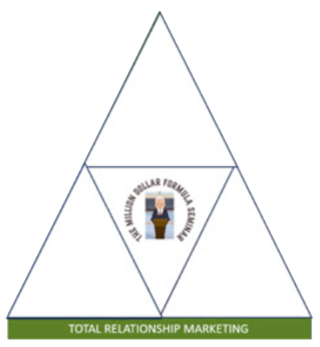
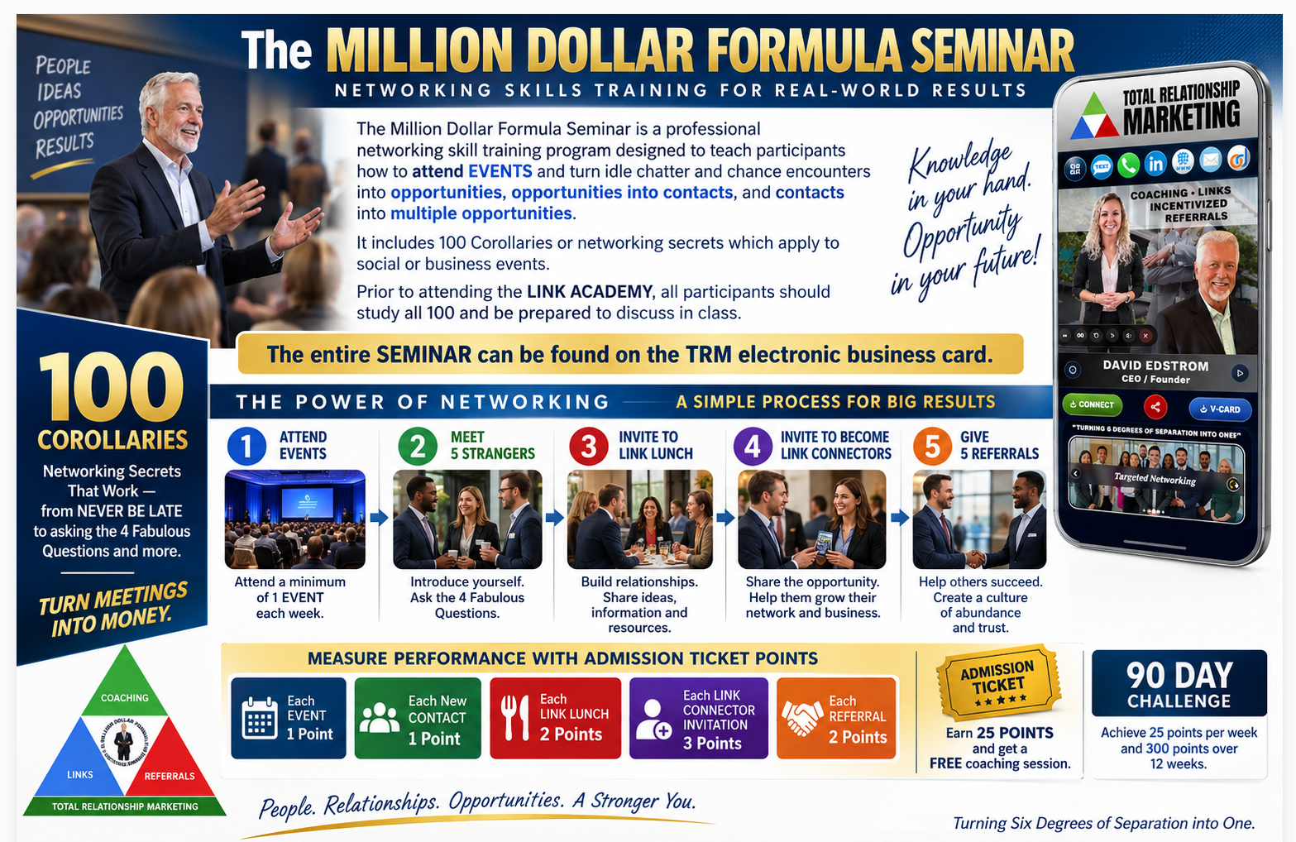

Slide 4
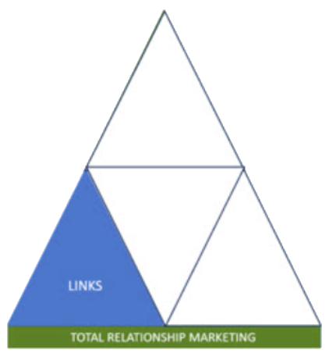
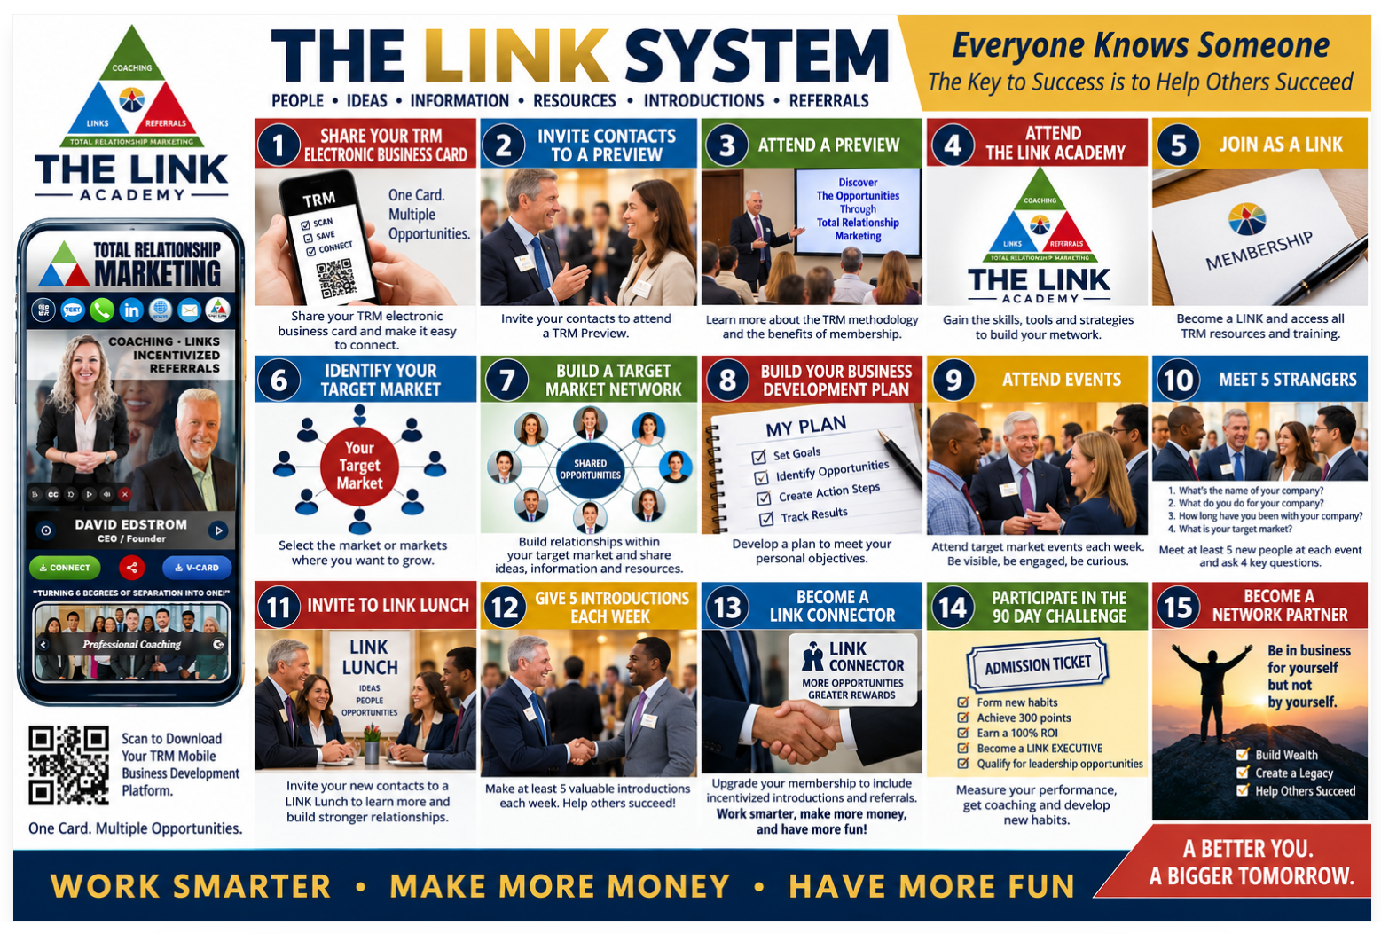

Slide 5

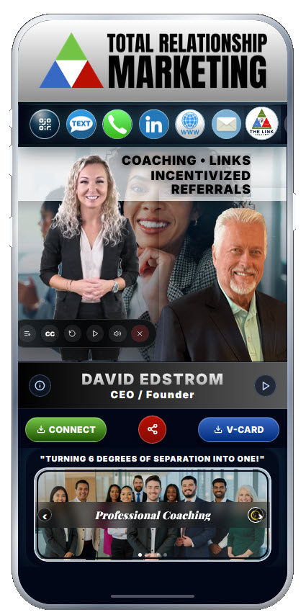
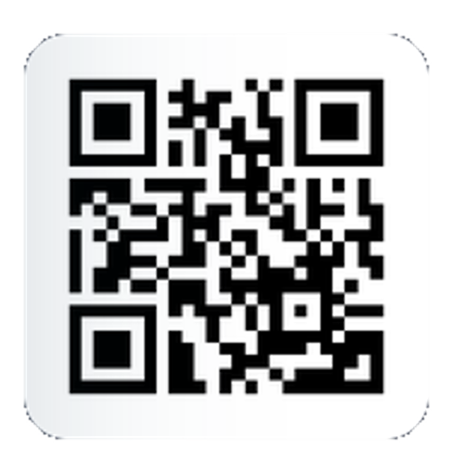

Slide 6

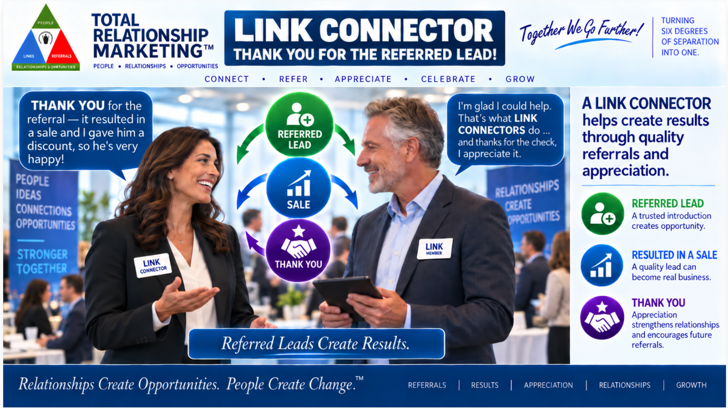

Slide 7
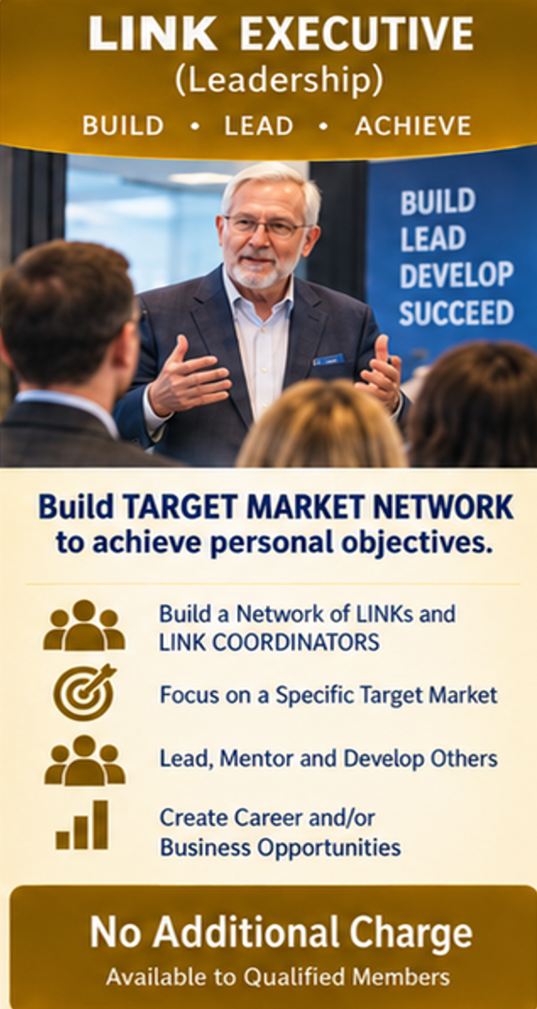
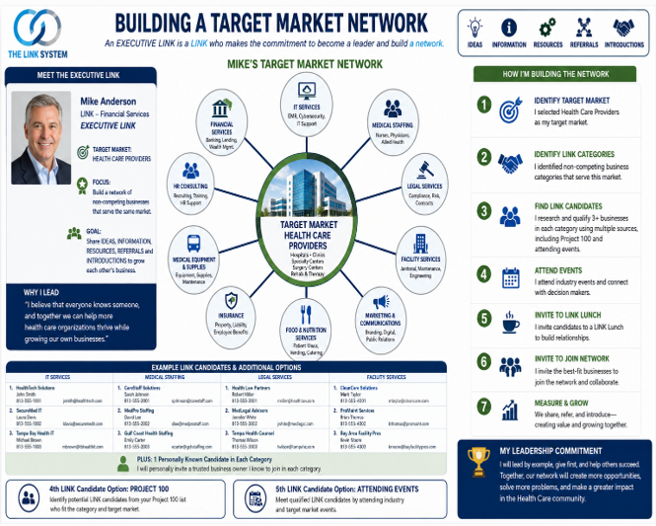

Slide 8
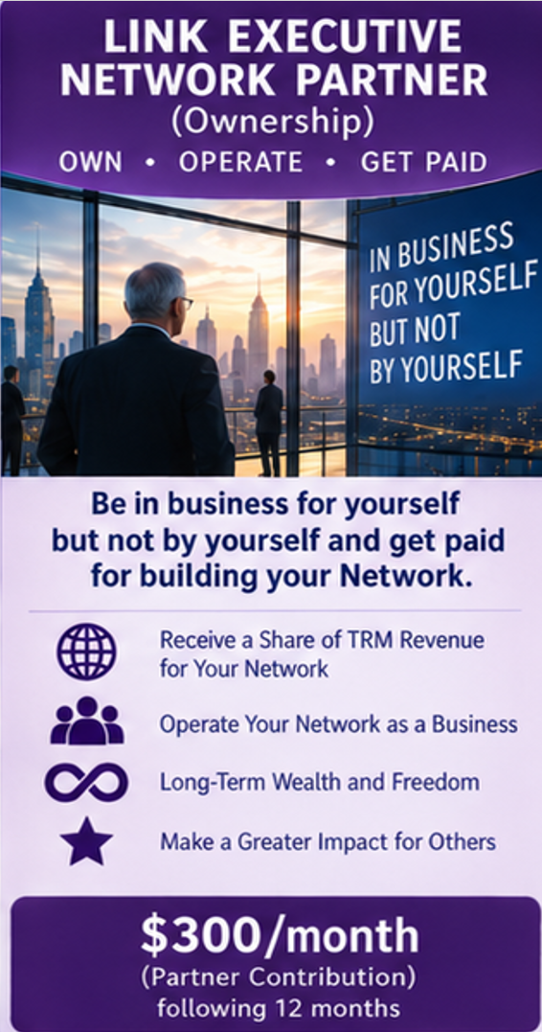
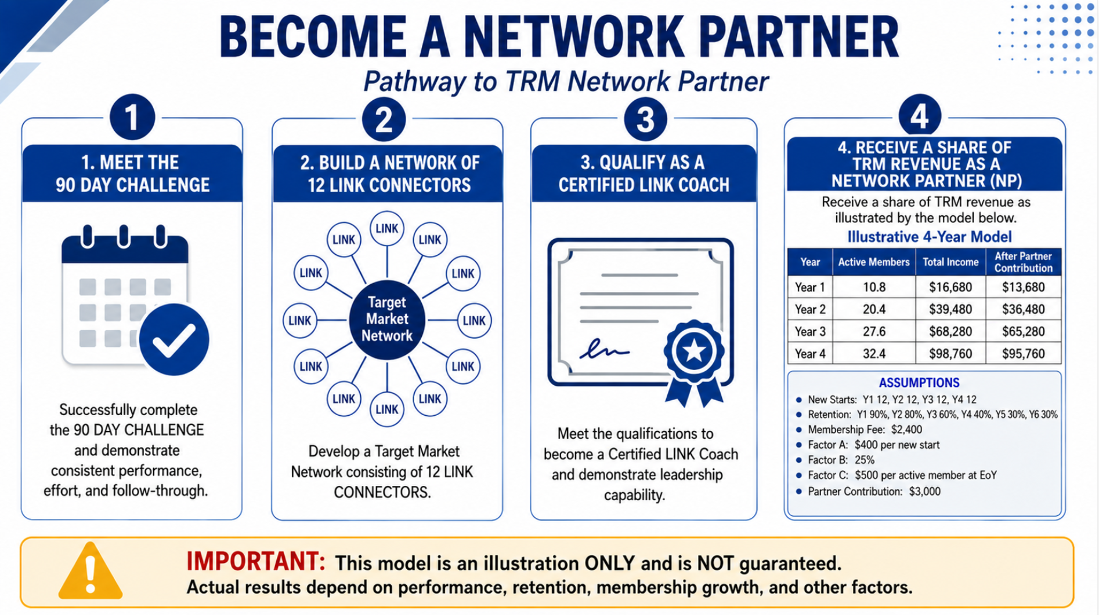

Slide 9
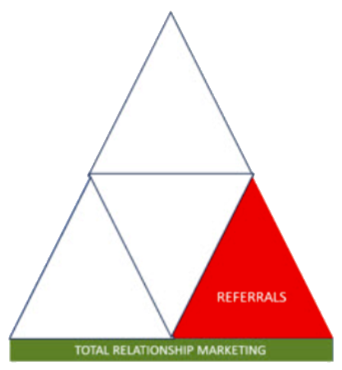
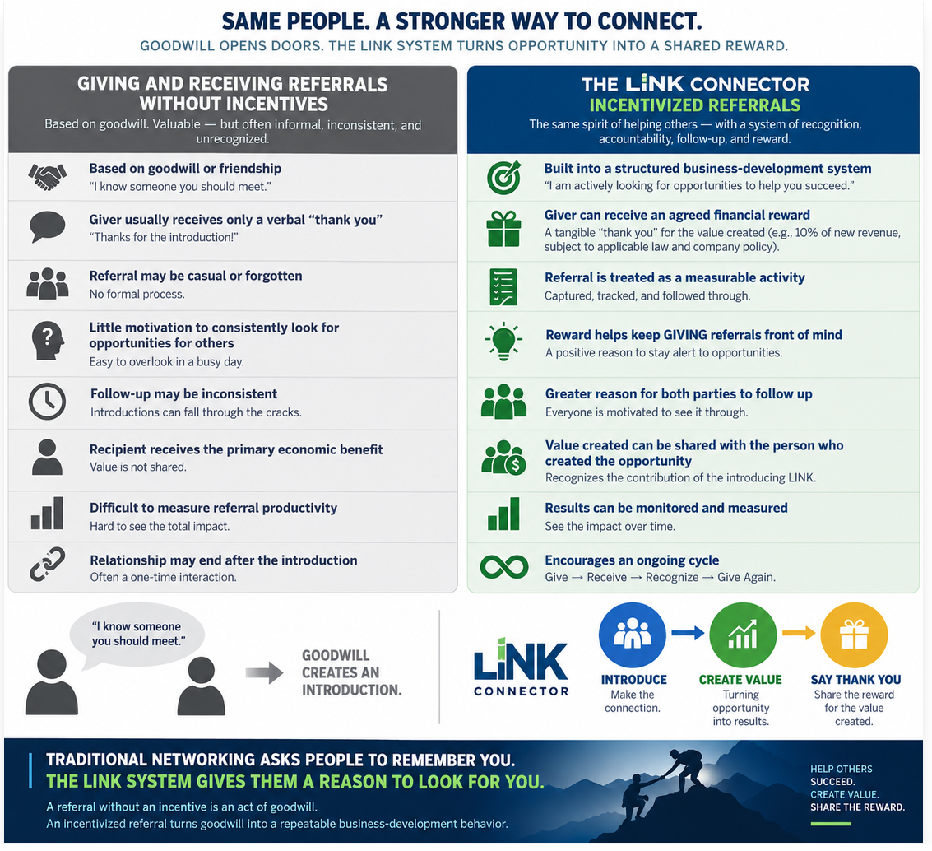

Slide 10
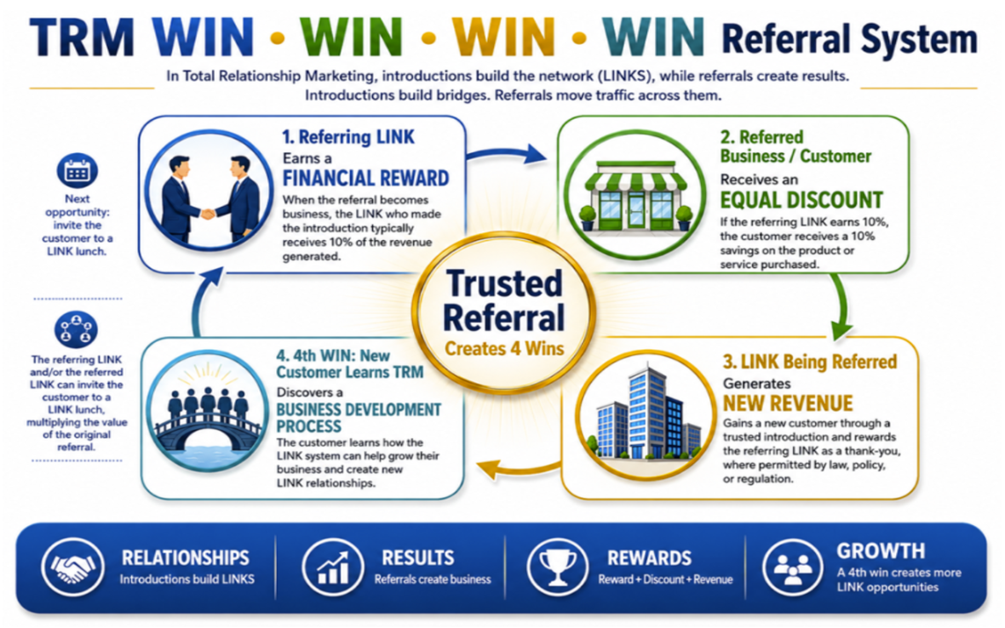


Slide 11
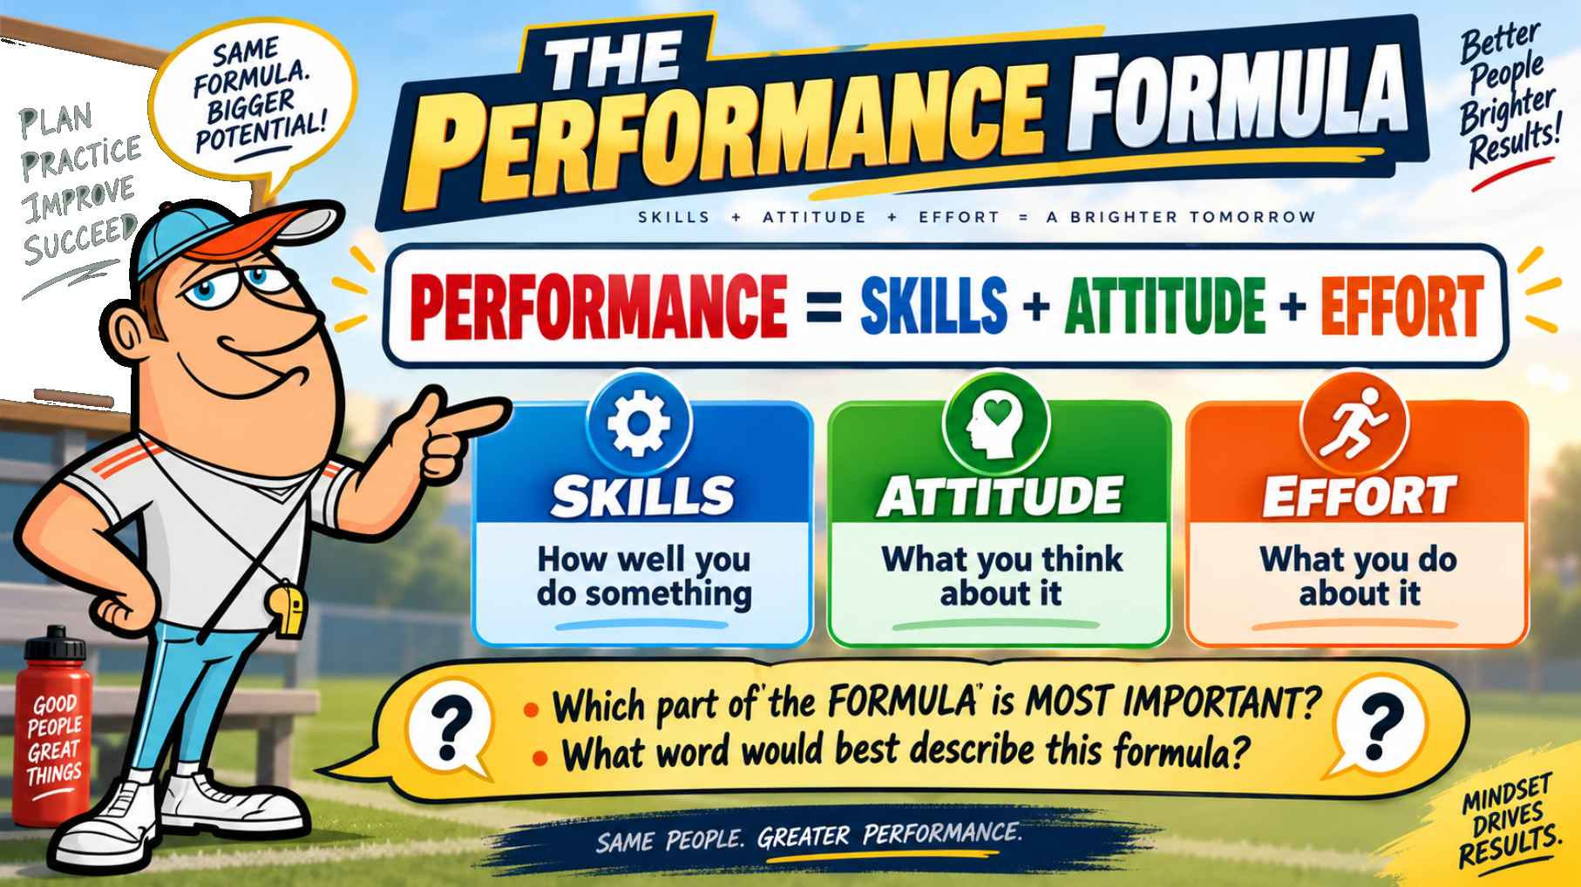

Slide 12
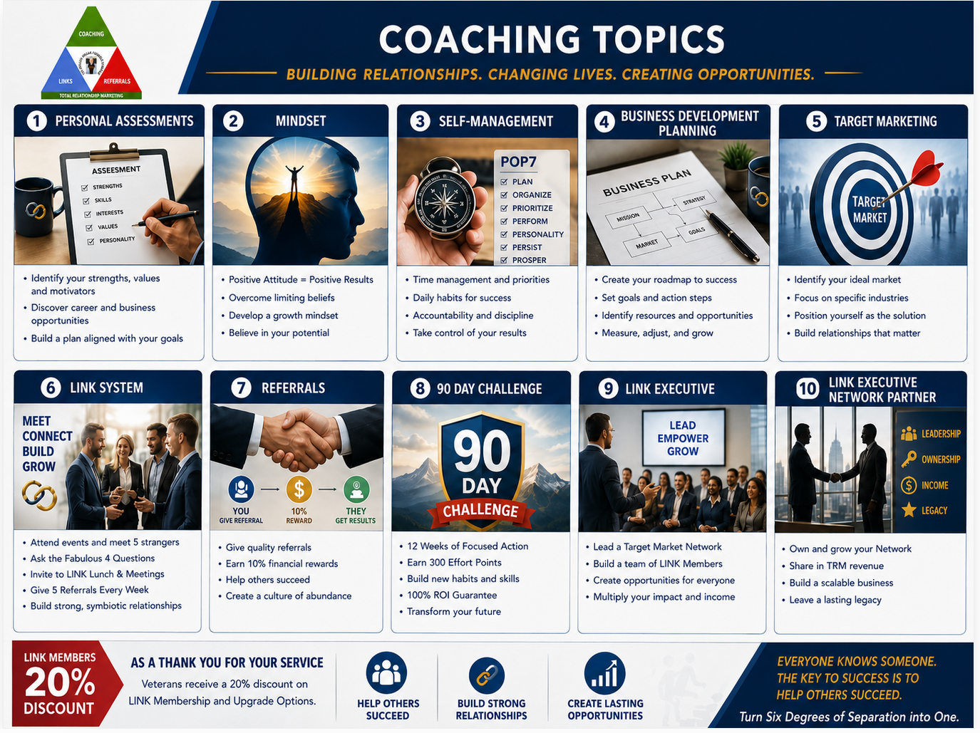

Slide 13
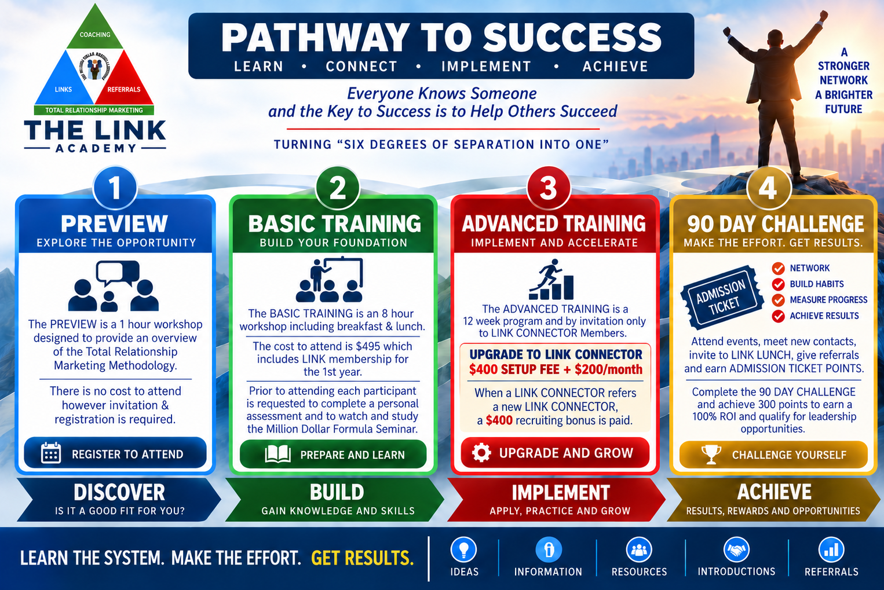


Slide 14
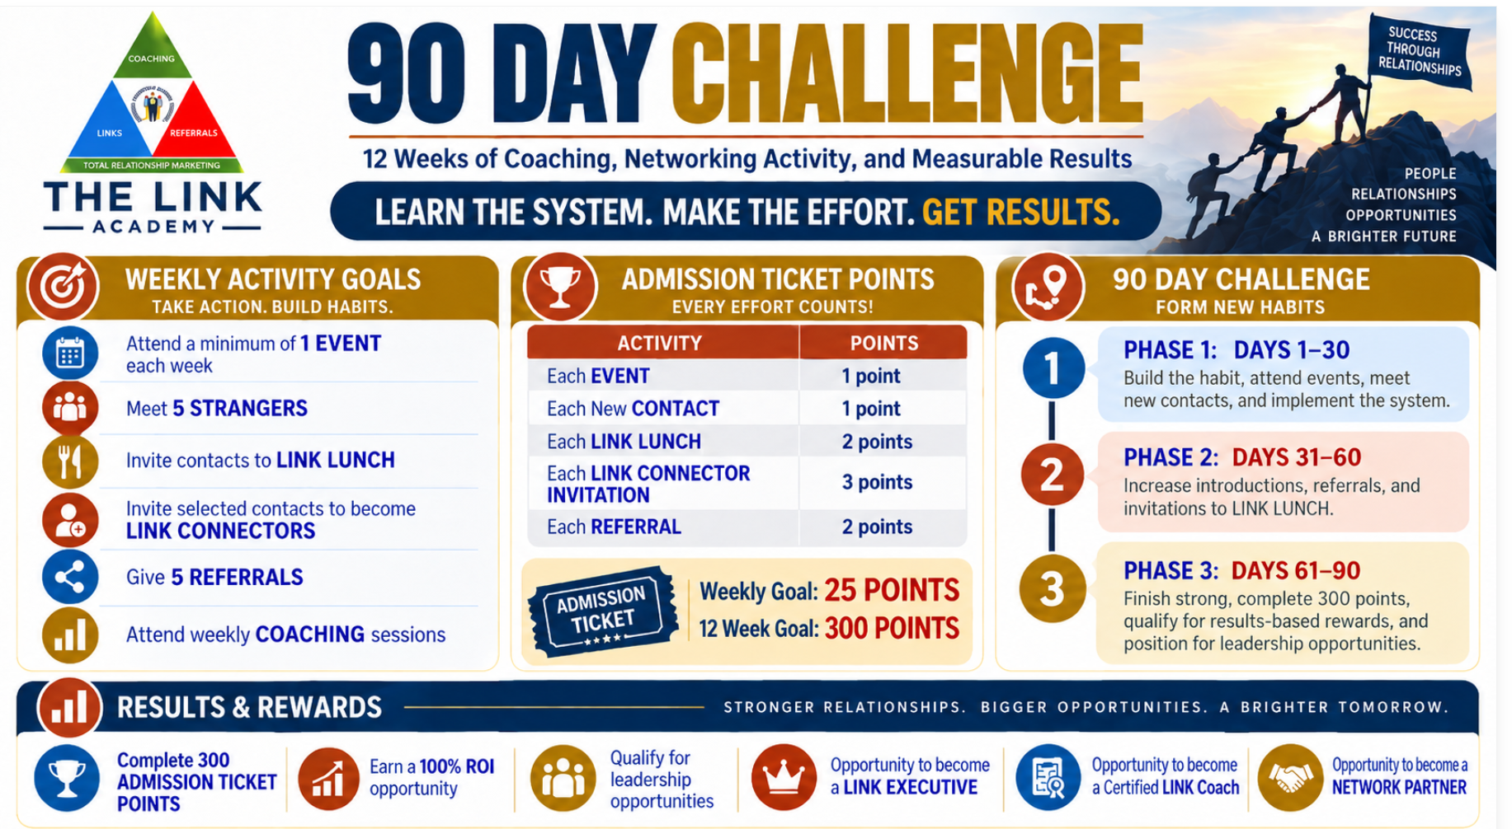

Slide 15
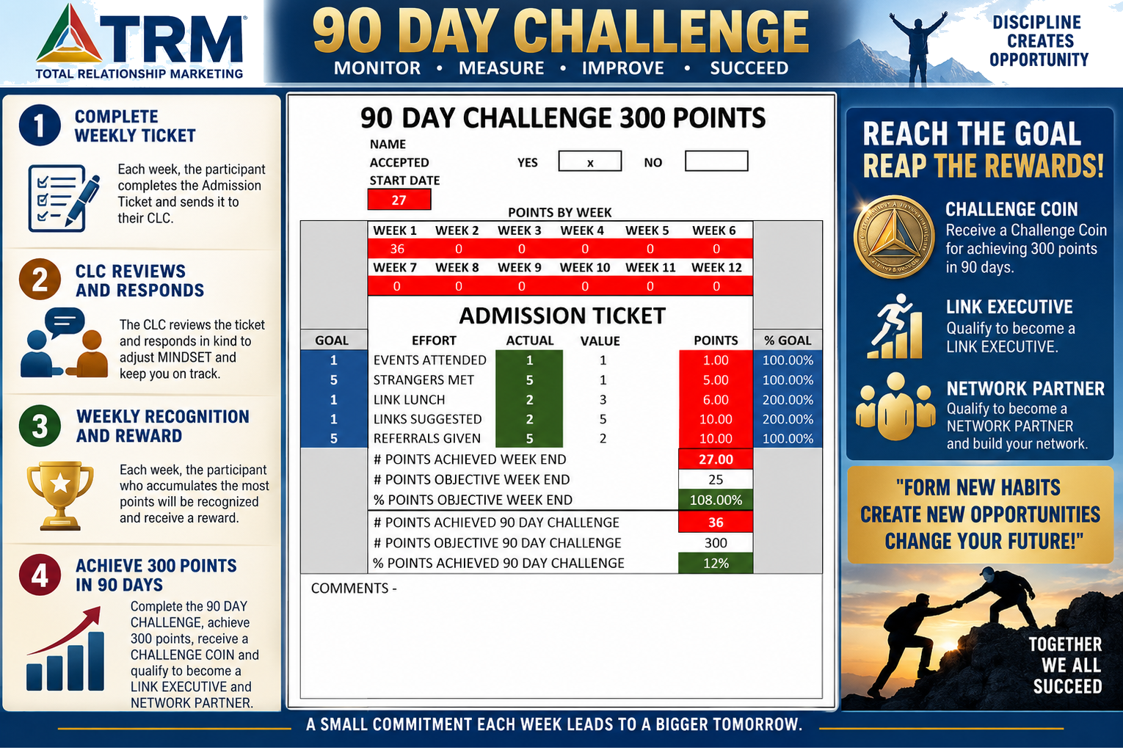

Slide 16
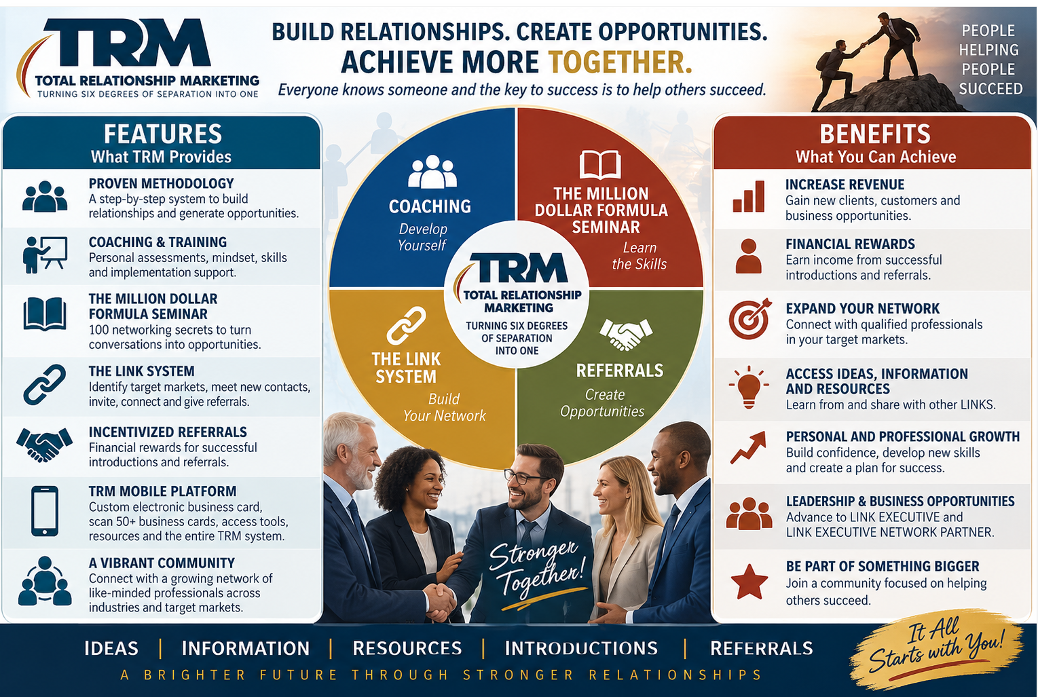

Slide 17
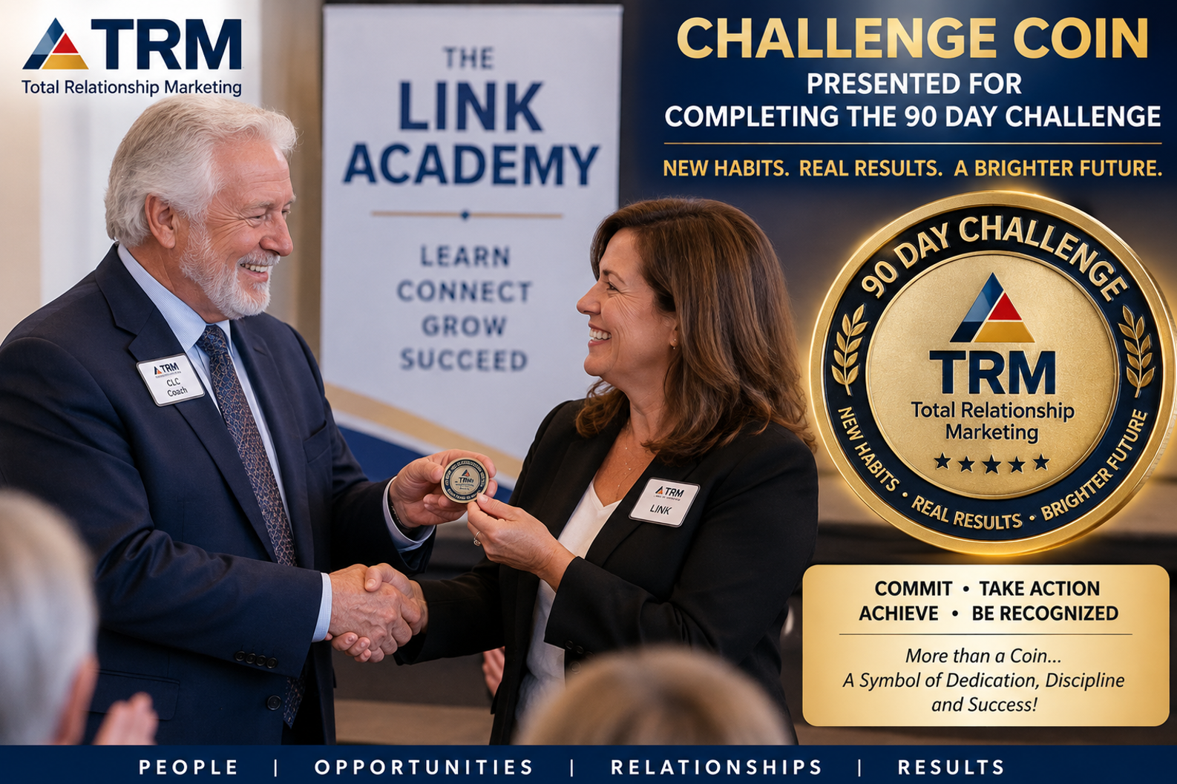

Slide 18
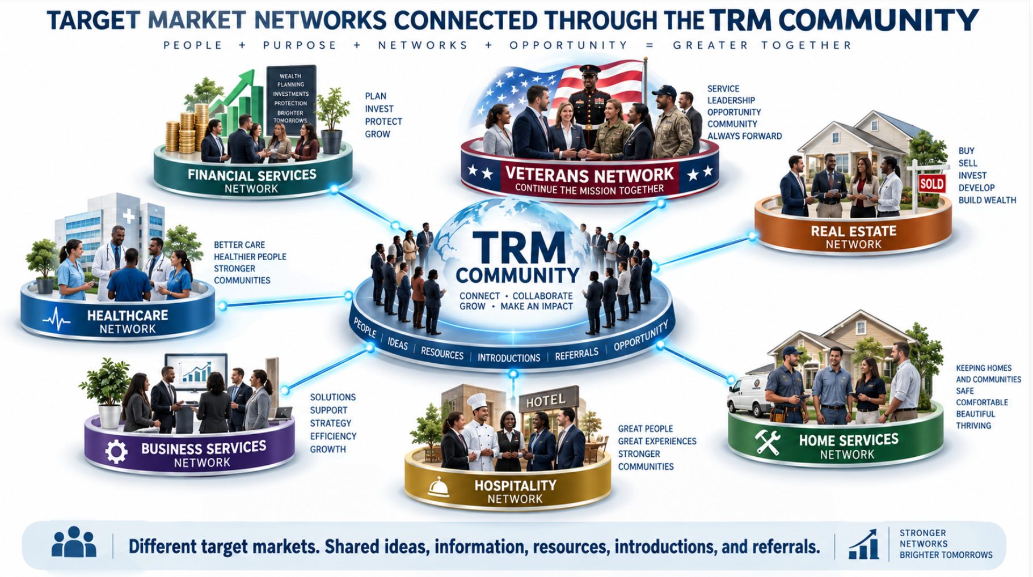

Slide 19
